Slide 1


Clustering Example
Data: Water Treatment Plant (1993)
Source: https://archive.ics.uci.edu/ml/datasets/water+treatment+plant

Slide 2
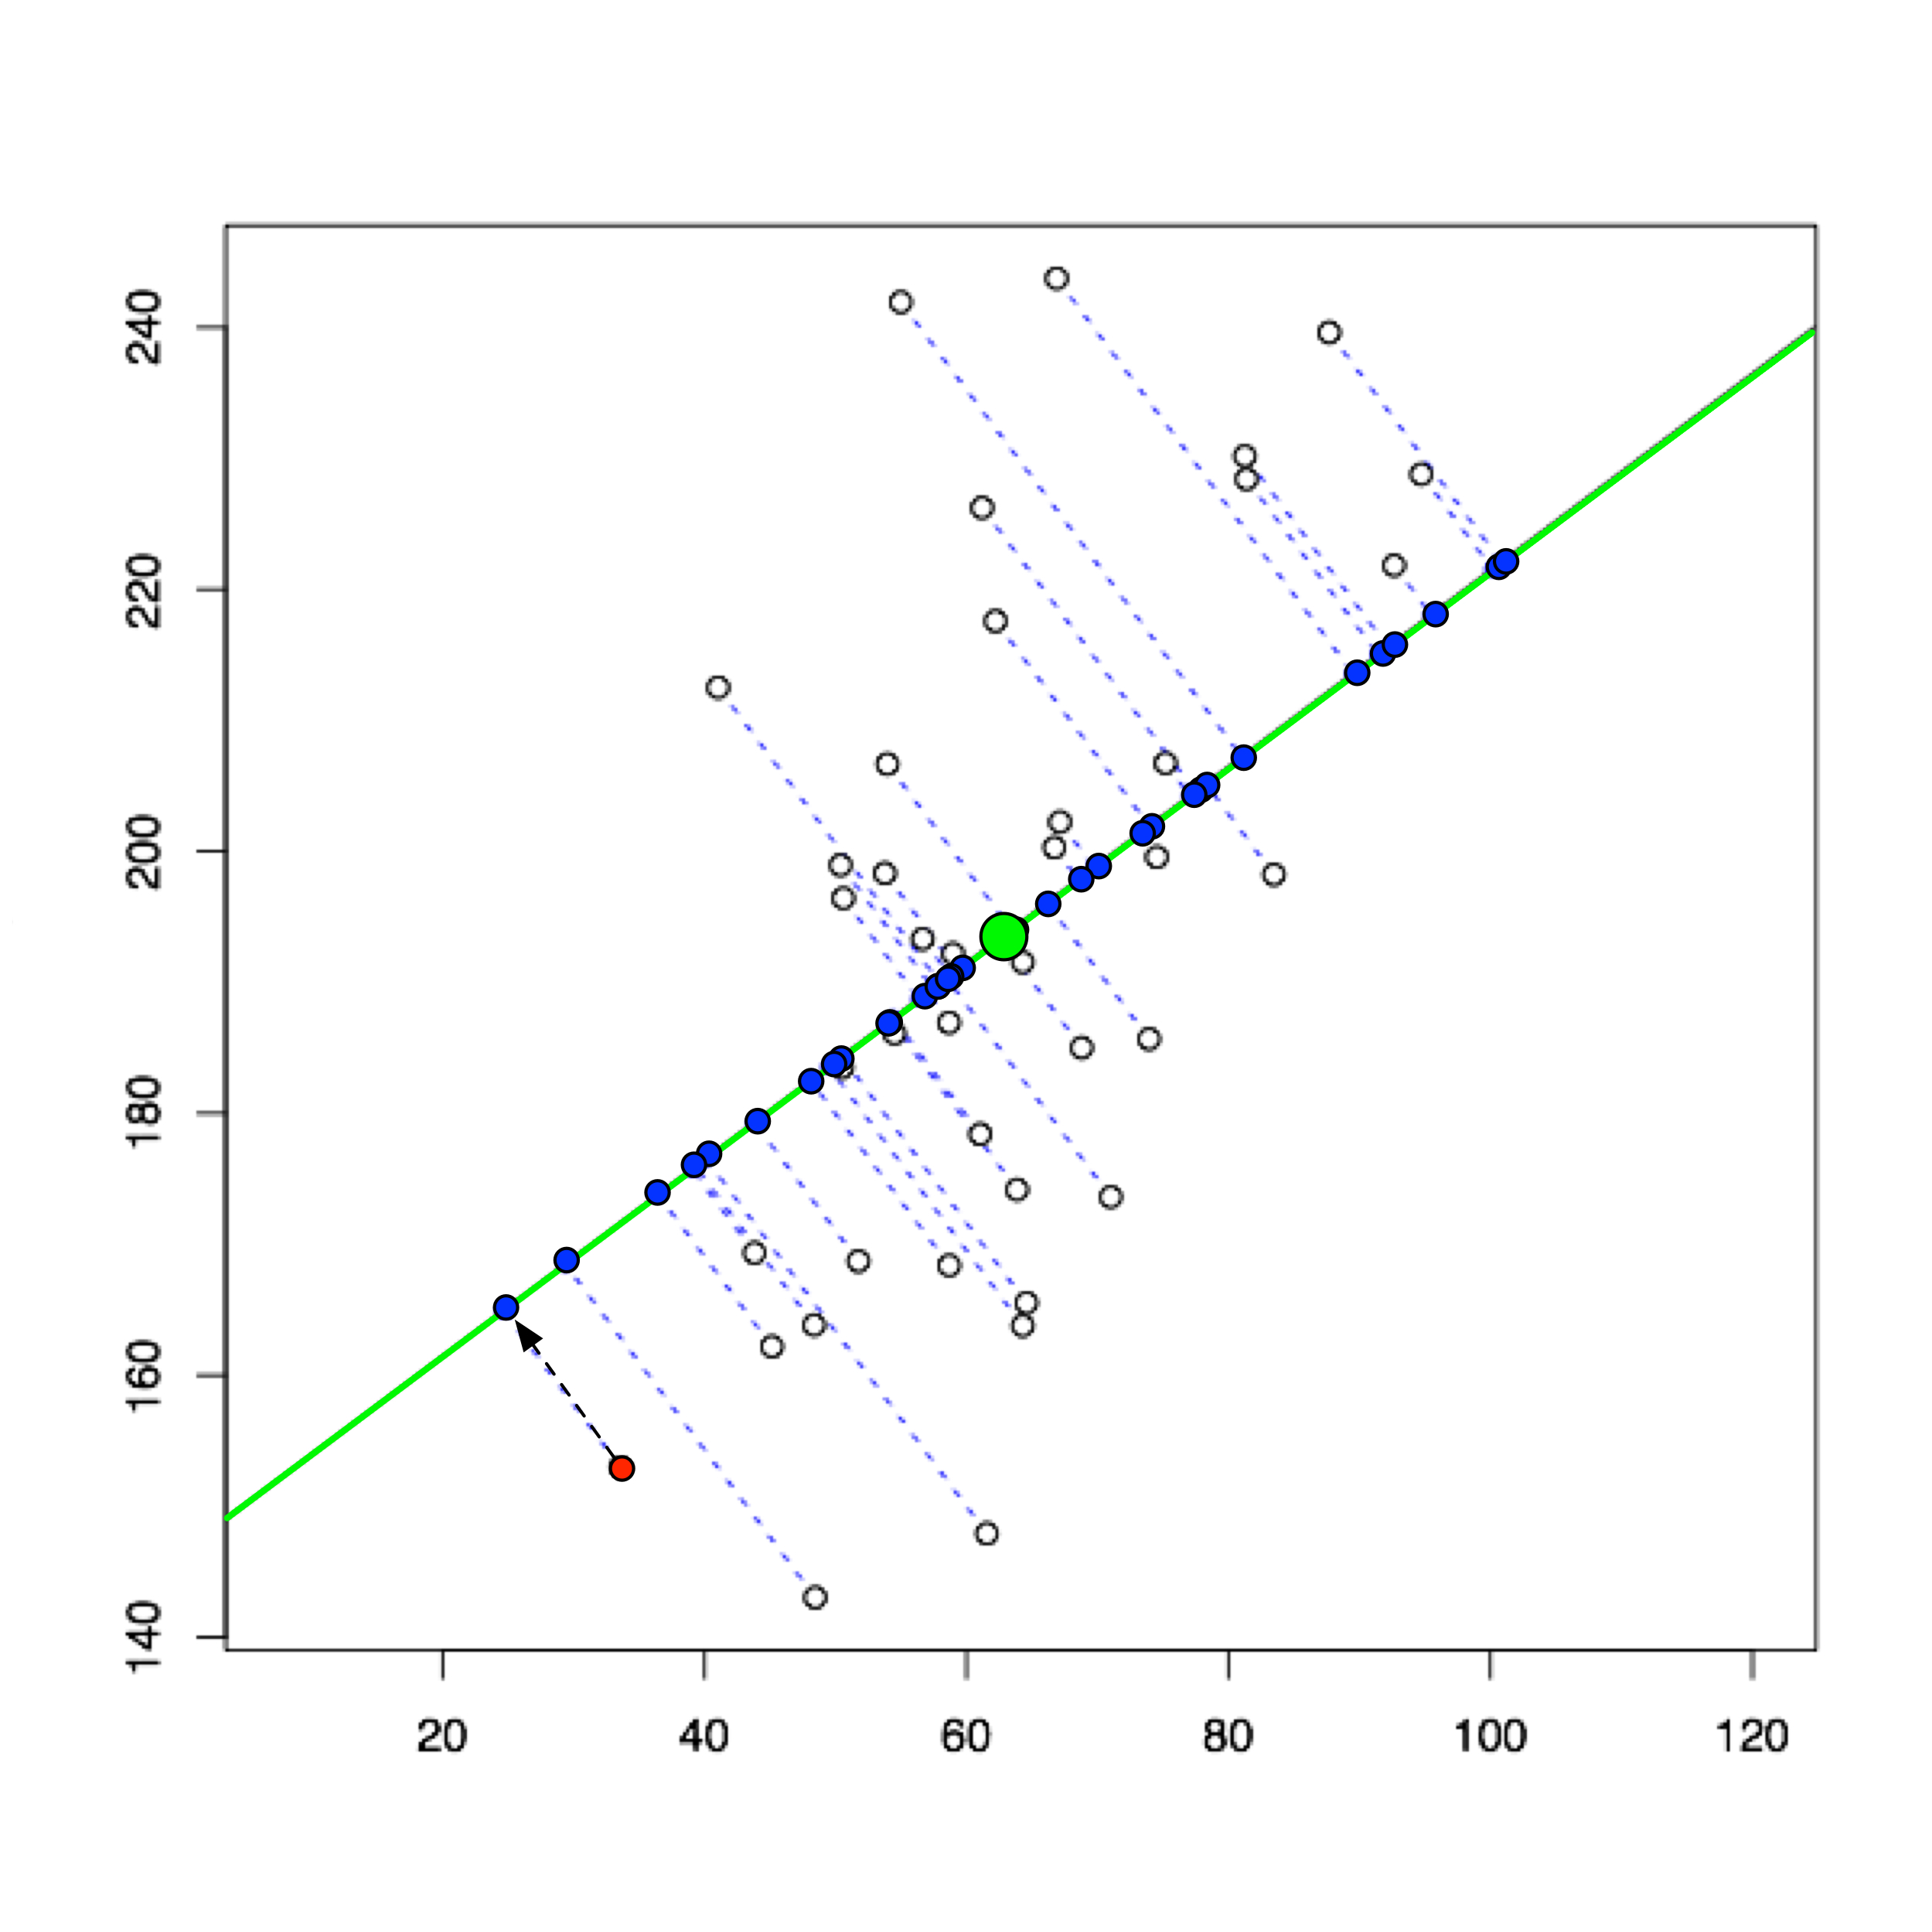
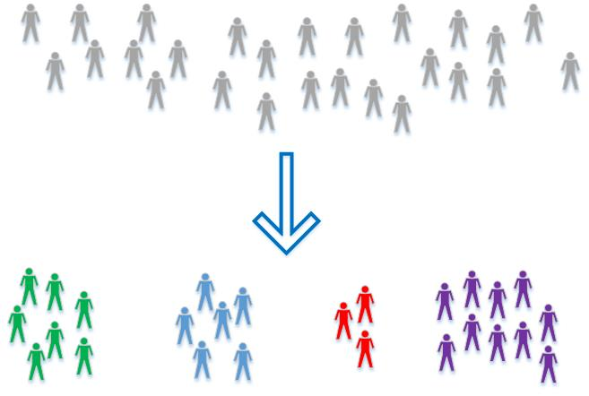
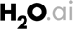
Unsupervised Learning – Discover Hidden Patterns
Clustering:
Customer Segmentation
Dimensionality Reduction:
Linear Transformation of Variables
H₂O algos:
K-Means
Generalised Low Rank Model
H₂O algos:
Principal Component Analysis
Generalised Low Rank Model

Slide 3
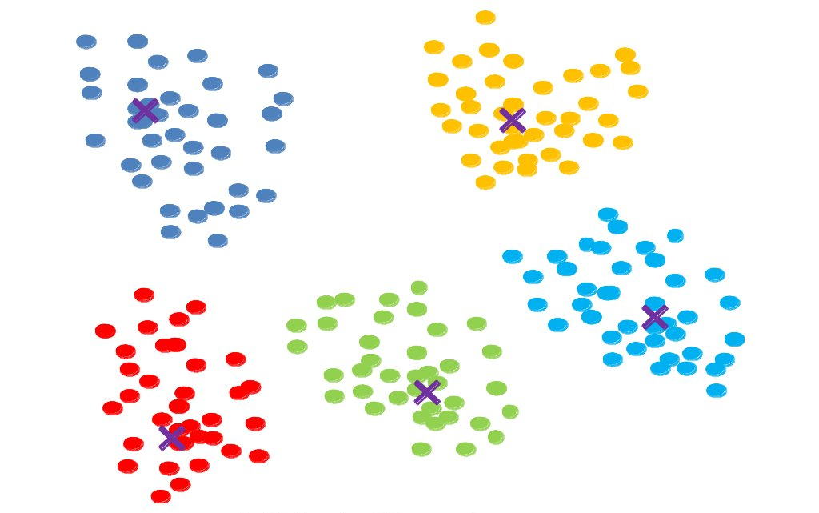
K-Means Clustering

Slide 4
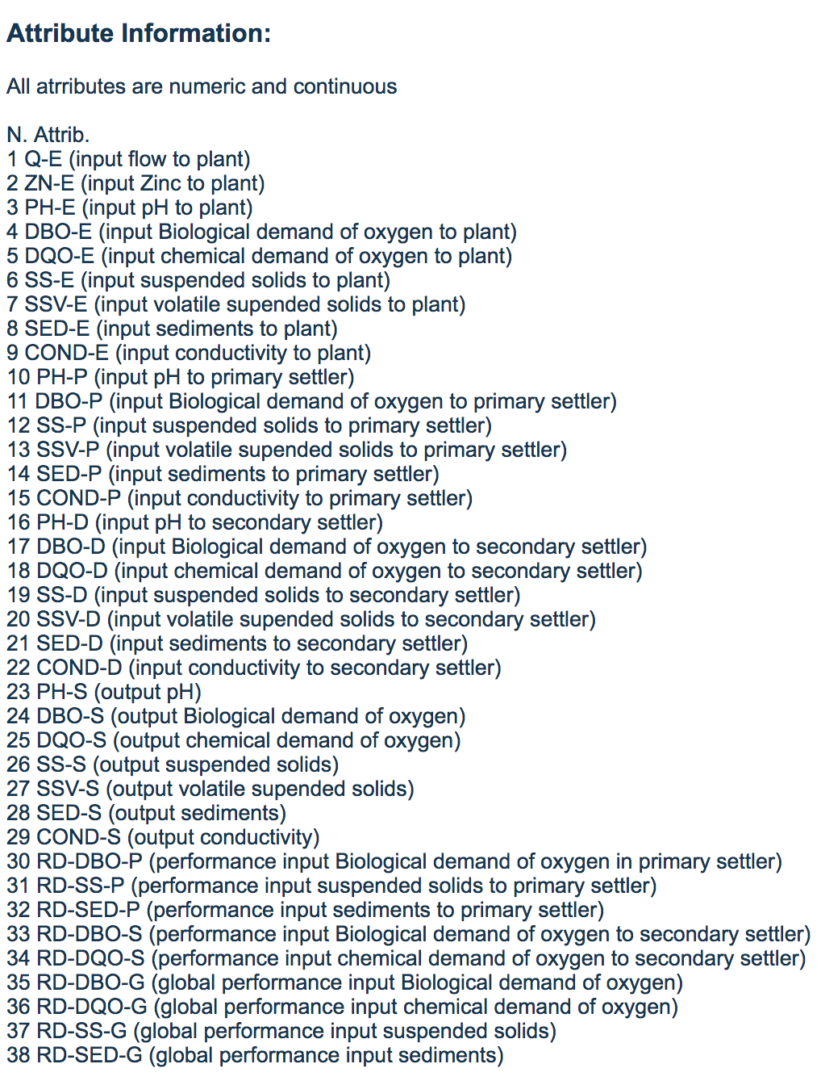
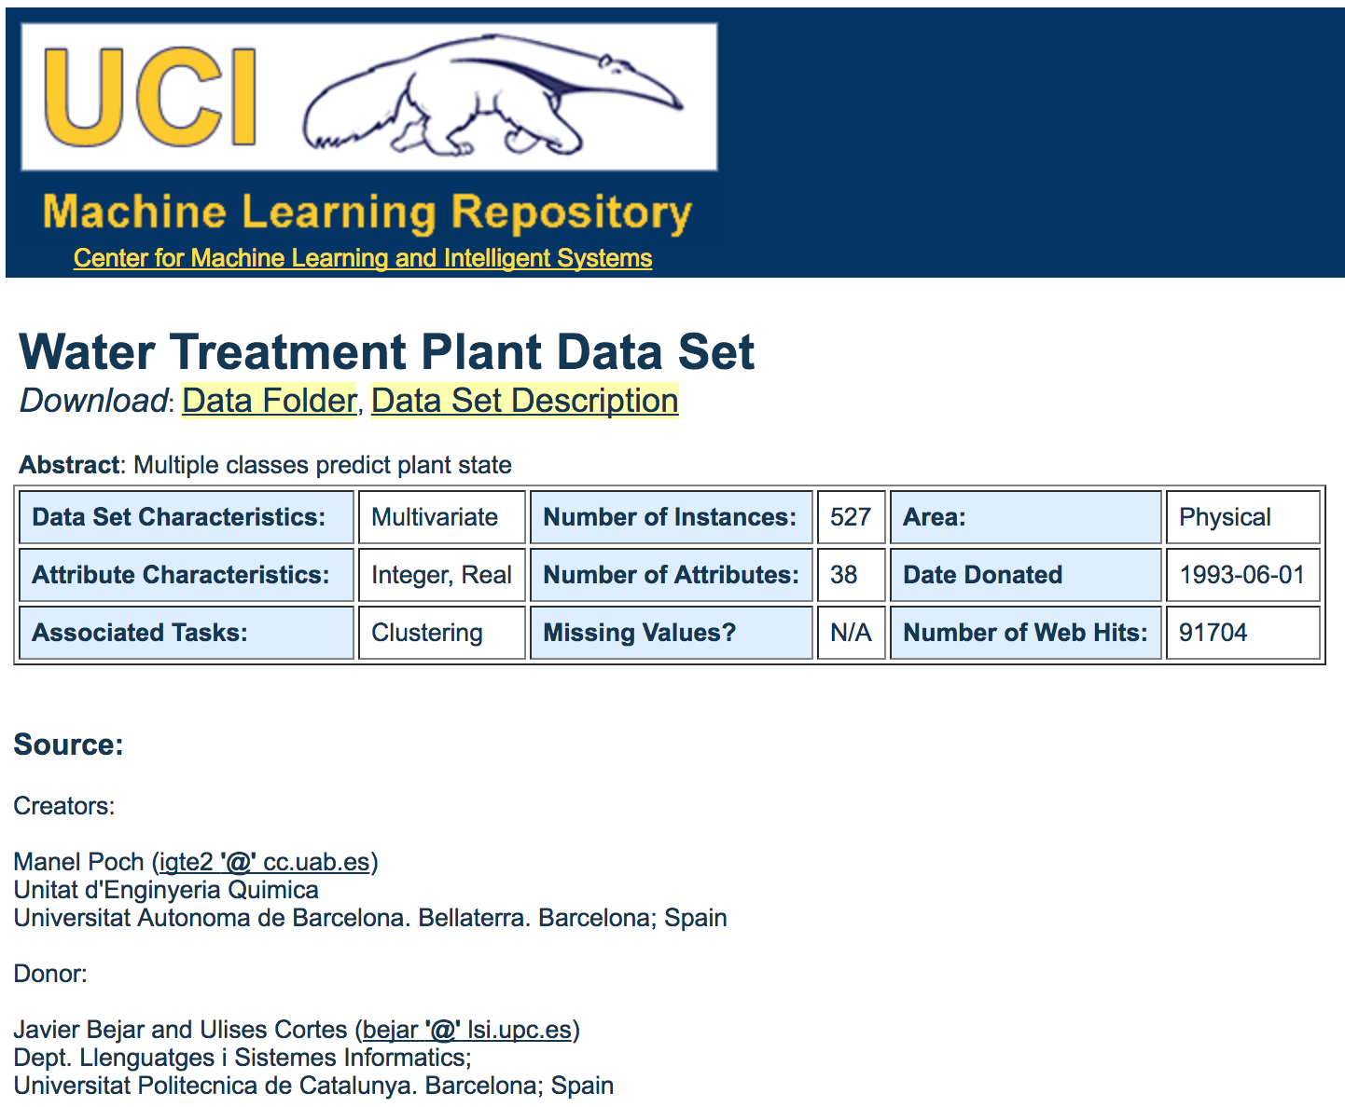

Slide 5
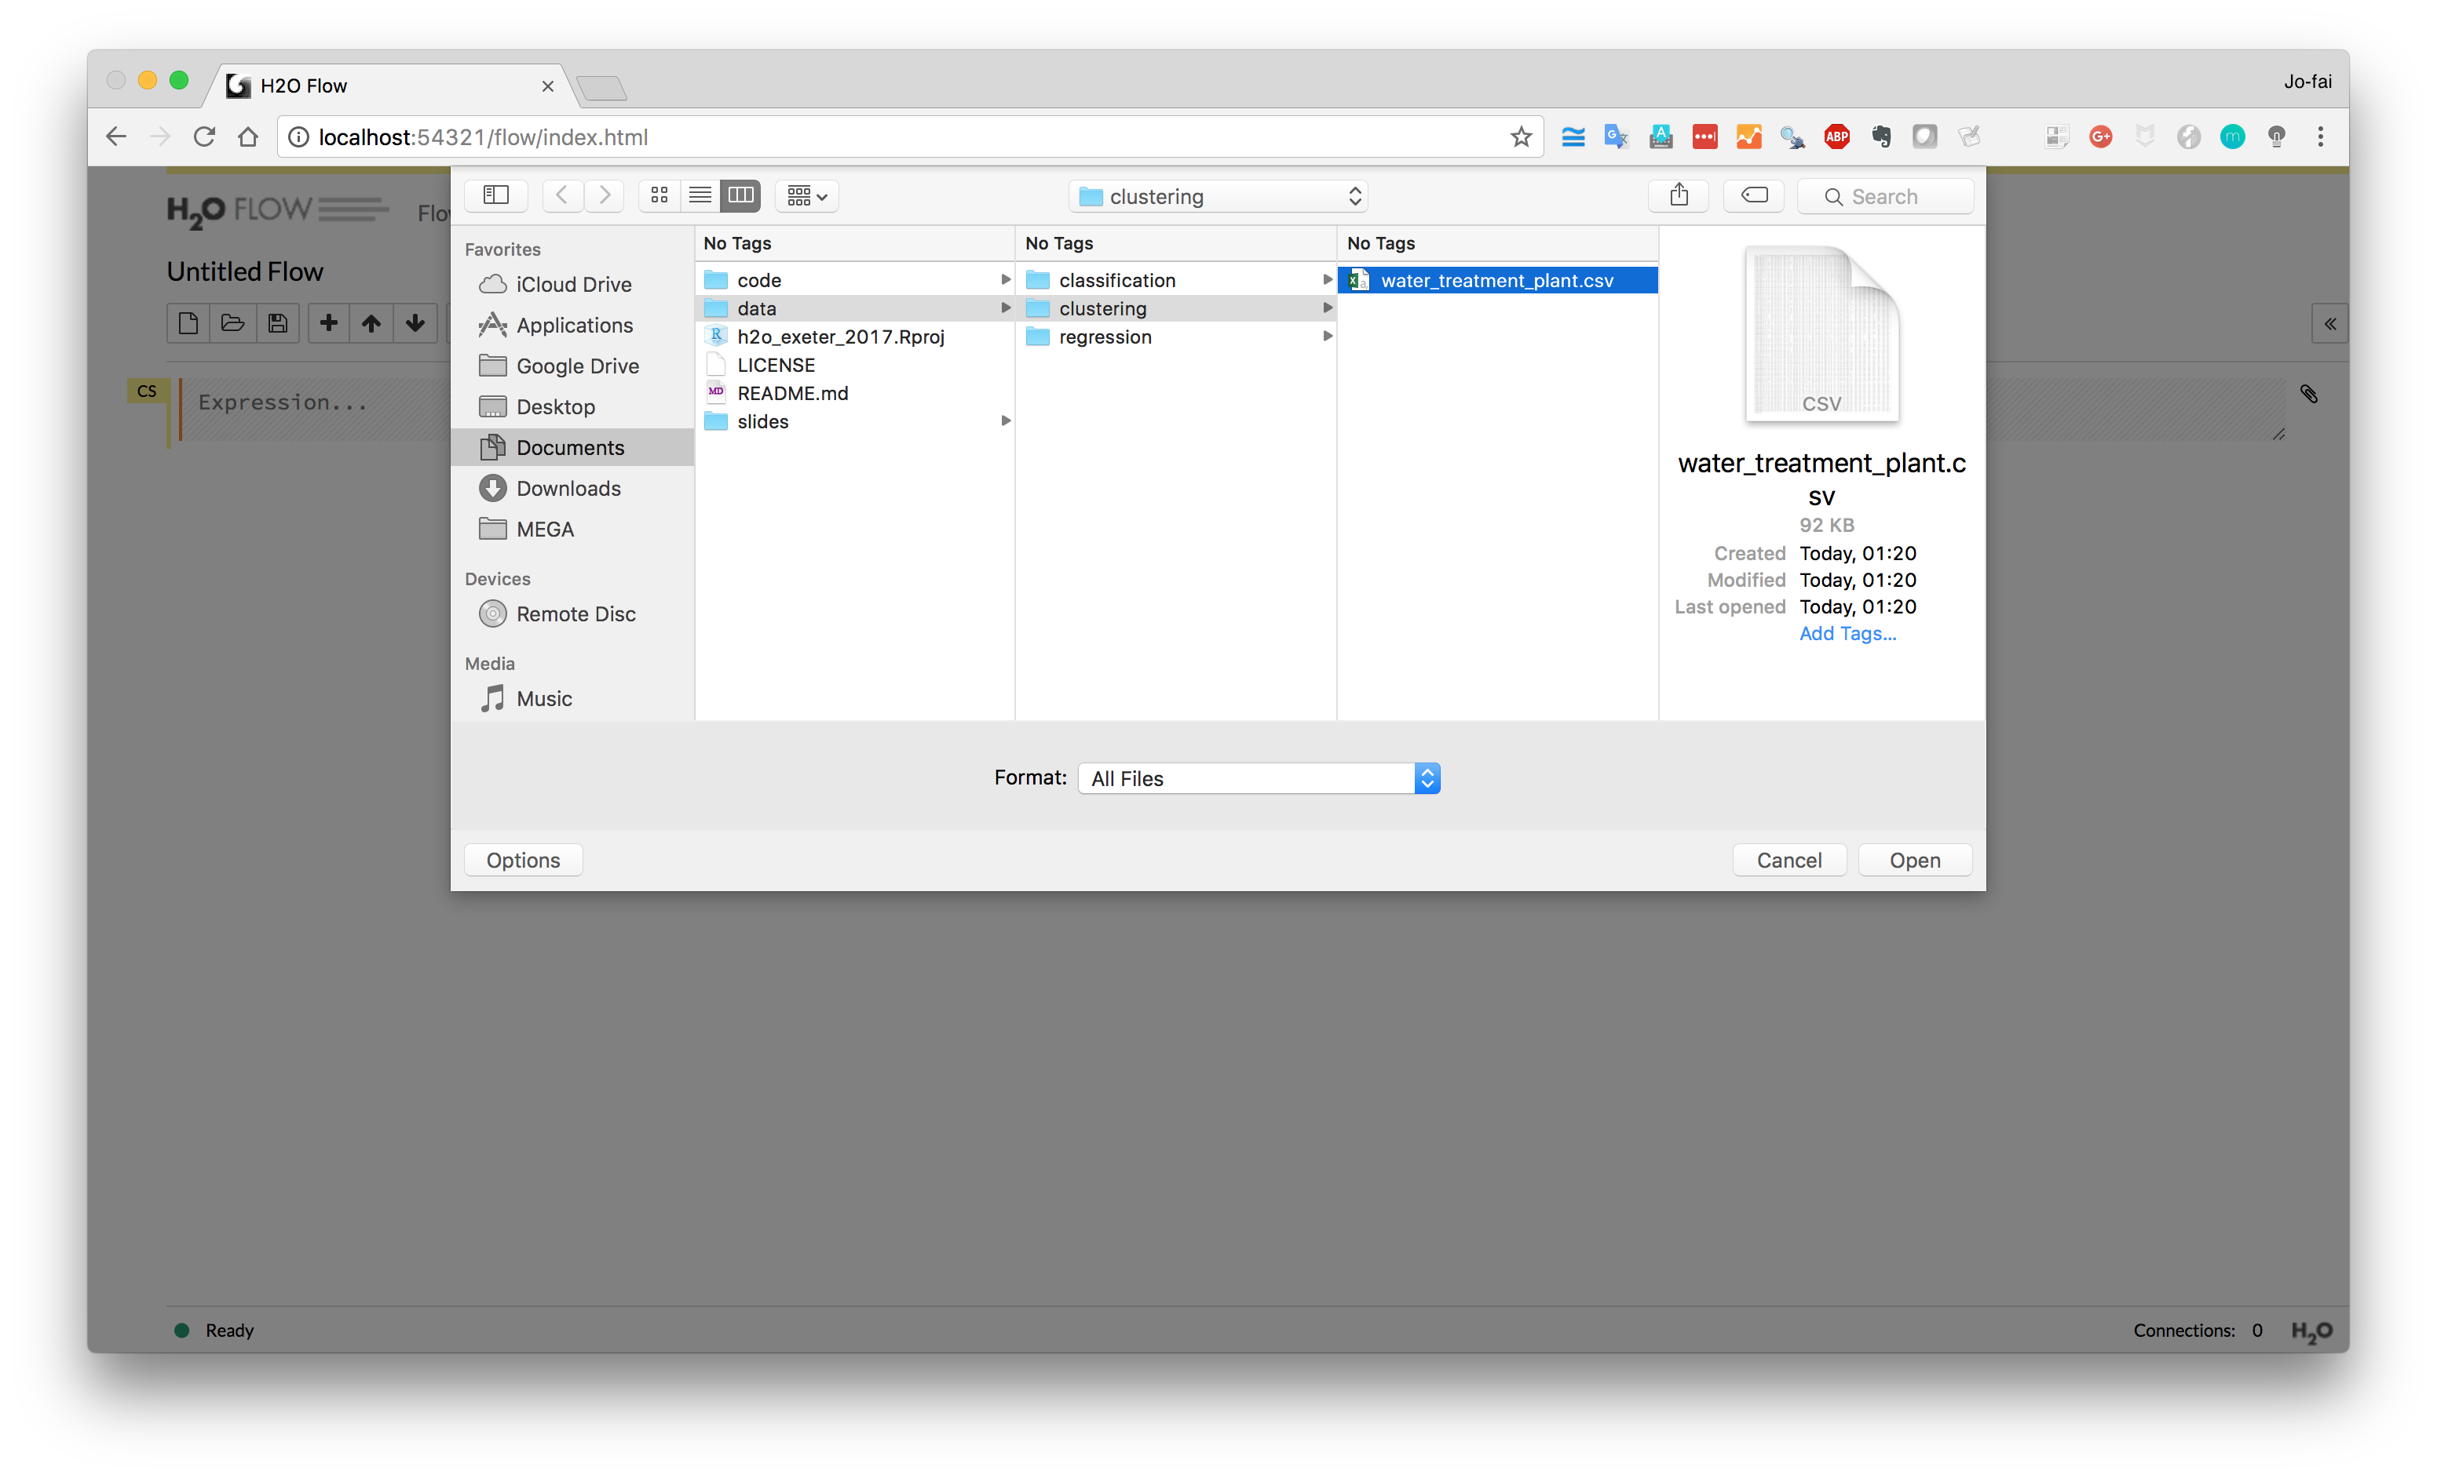

Slide 6
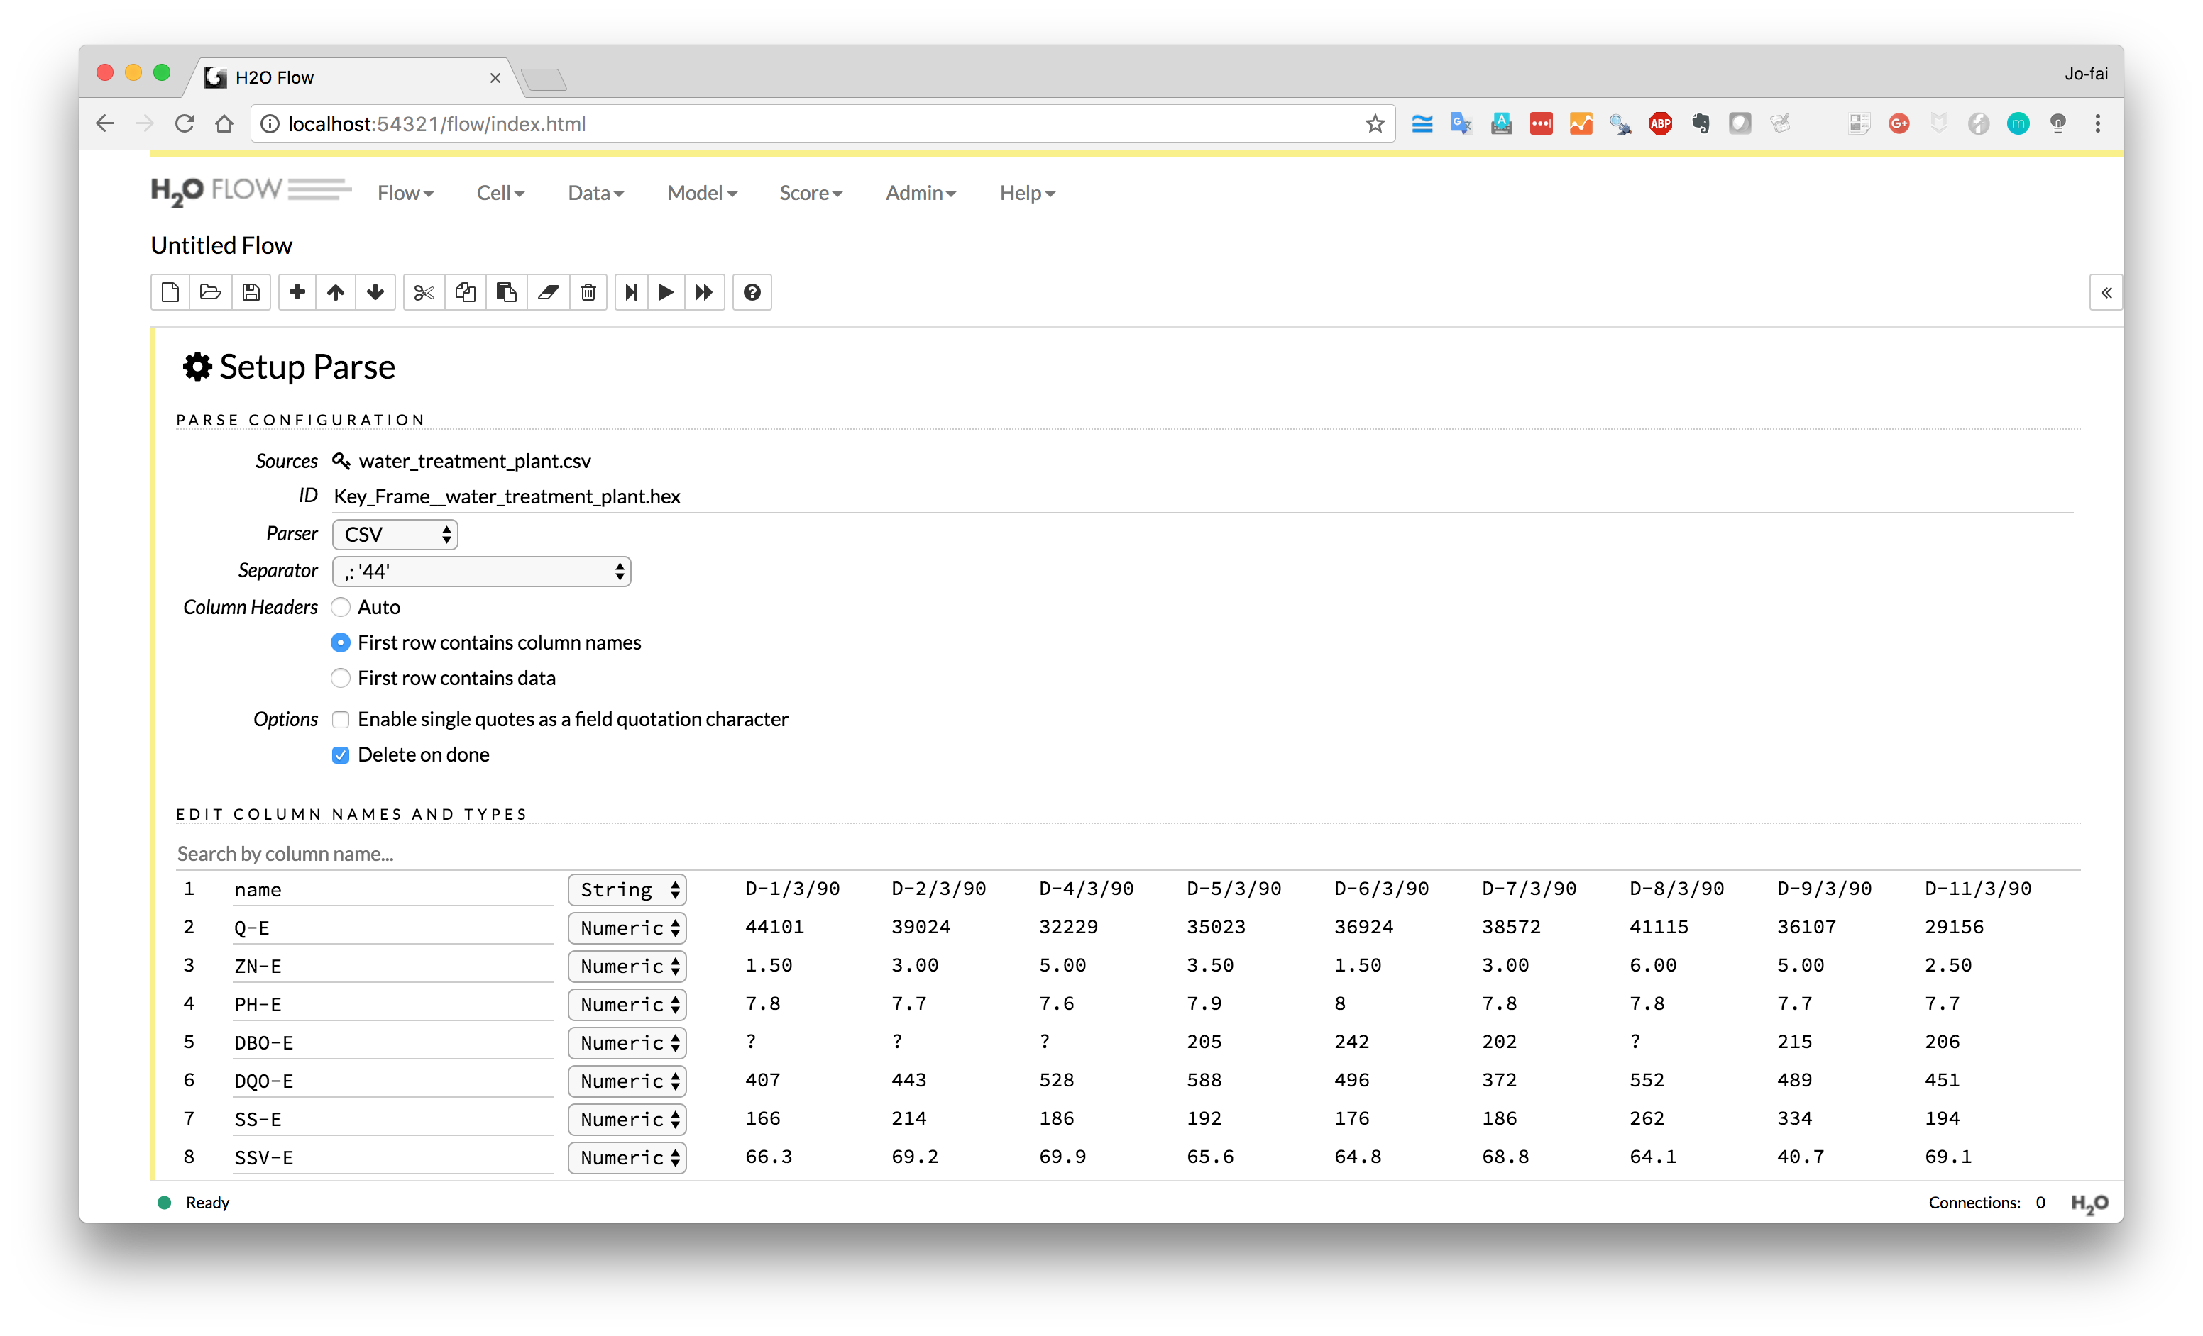

Slide 7
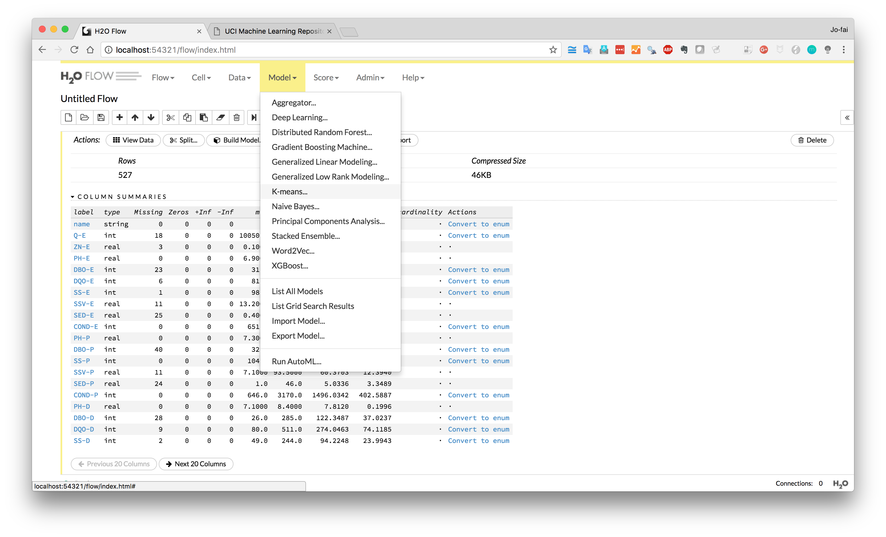
Model → K-means

Slide 8
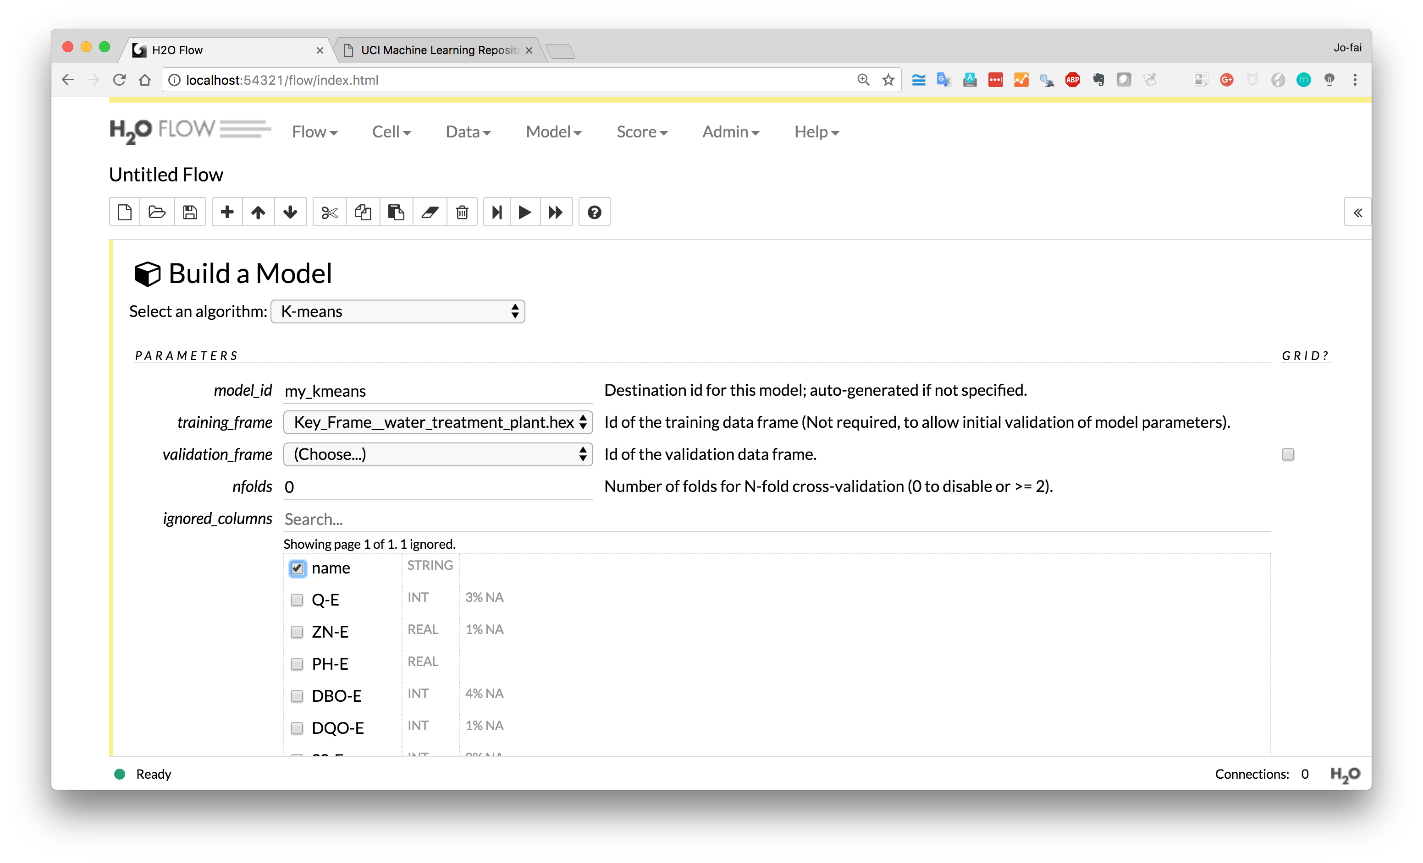
Ignore variable “name”

Slide 9
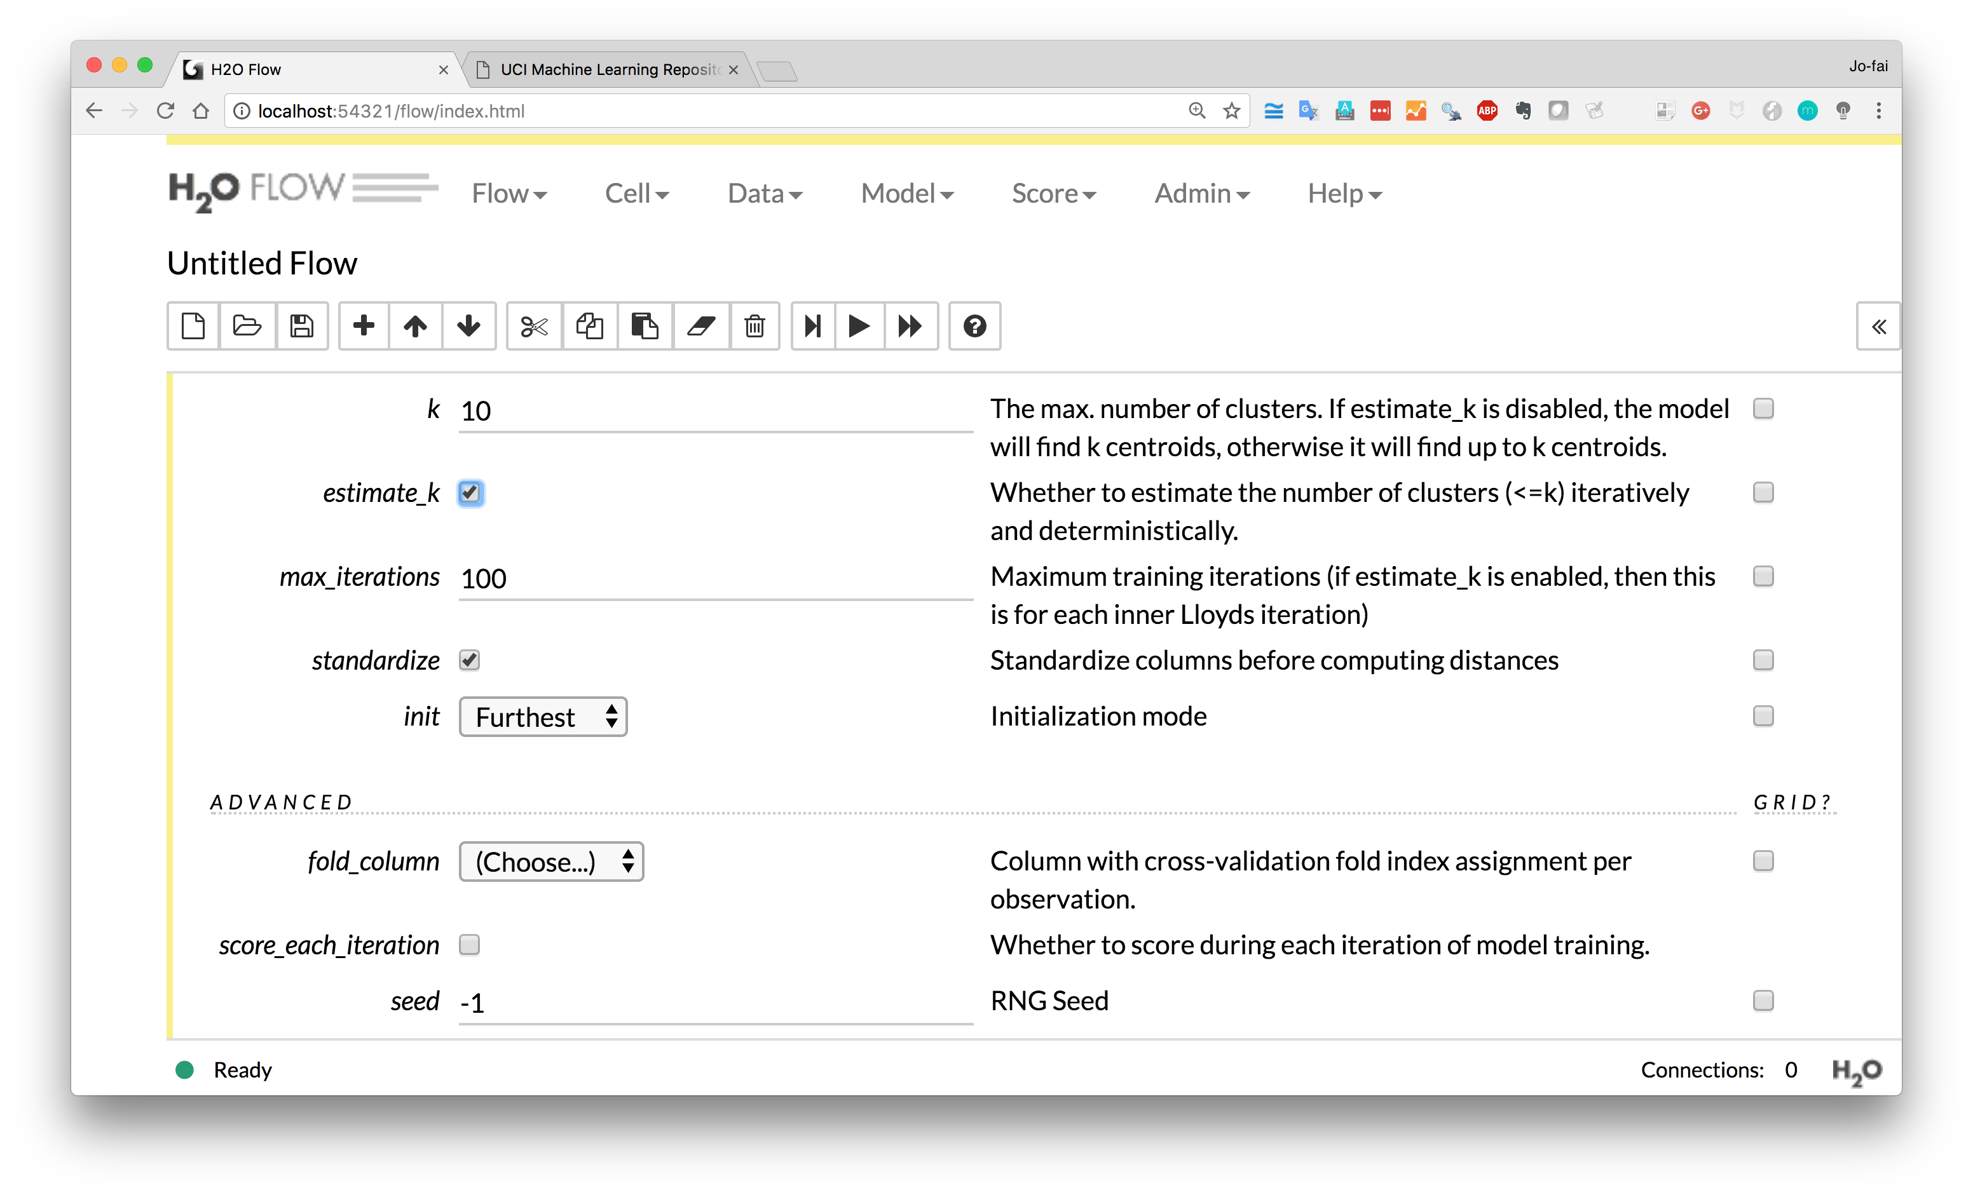
Enter k = 10
Choose “estimate_k”
max_iterations = 100

Slide 10
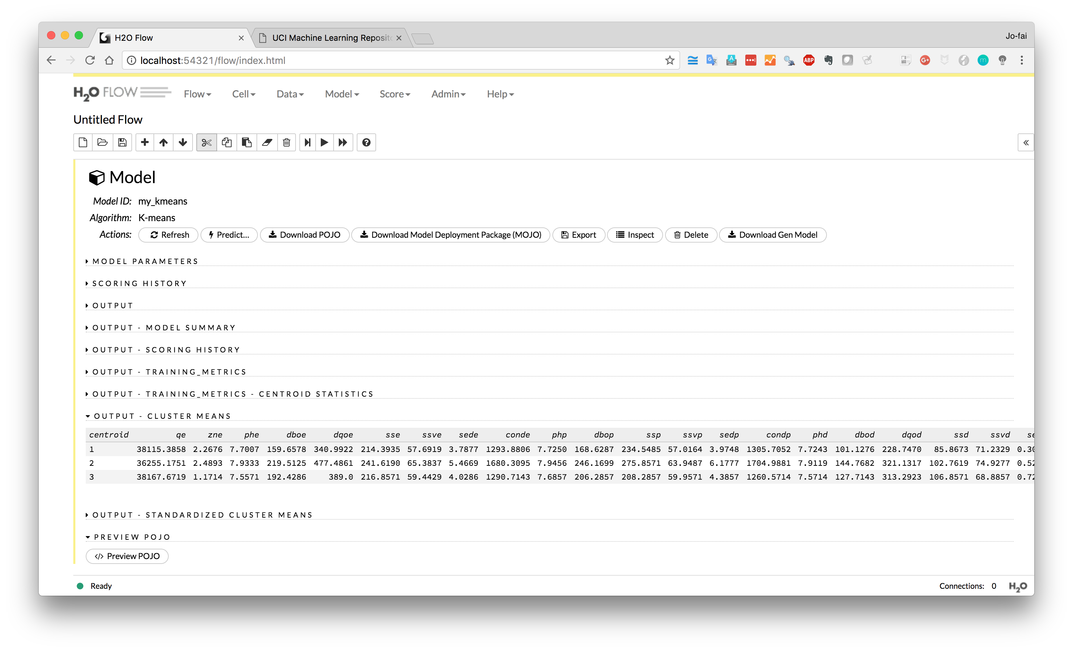
H₂O finds optimal k = 3

Slide 11
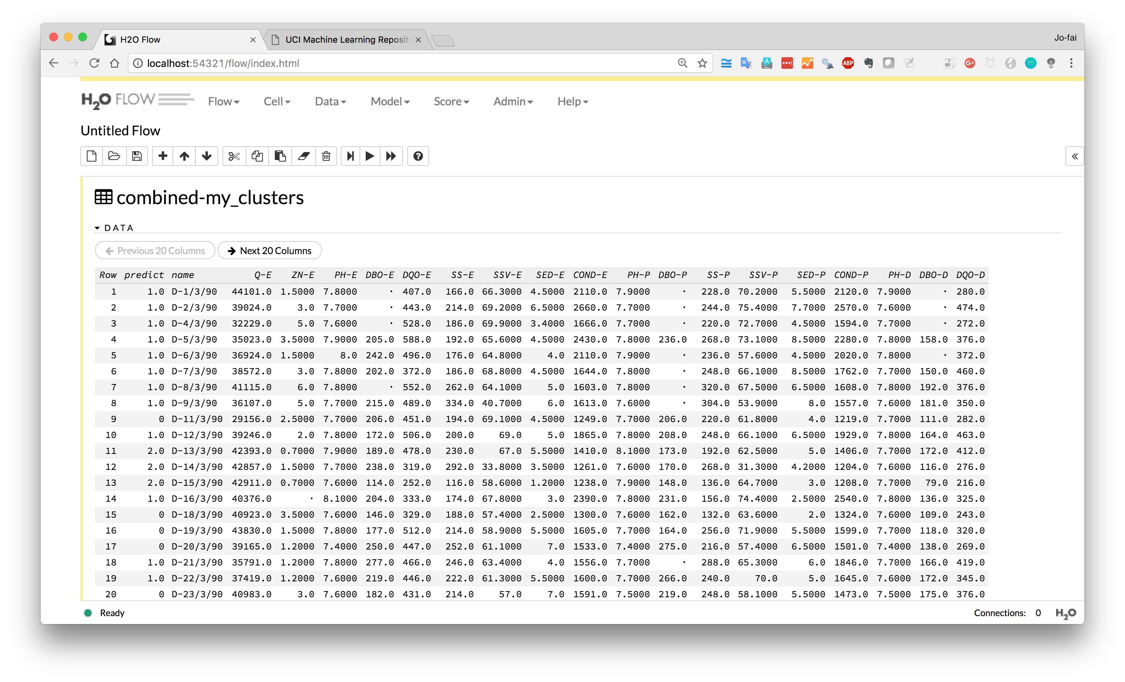
Make predictions
Three clusters (0, 1 or 2)

